Slide 1
بسم الله الرحمن الرحيم

Slide 2
Case presentation
Resident: Sara Salah

Slide 3
History :
Female patient 35 years old presented with sudden painful diminution of vision with redness and lacrimation of lt.eye of 1 day duration following blunt trauma .

Slide 4
Past history :
No past history of medical importance

Slide 5
Examination :
Eye : Irritable
Lacrimation
Conjunctiva : ciliary injection
Cornea: clinically free
Anterior chamber : total hyphema
Iris: cannot be seen
Pupil: cannot be seen
                Intraocular pressure :DH

Slide 6
Fundus :cannot be seen
Intraocular pressure : 30mmhg measured with Schiotz tonometer

Slide 7
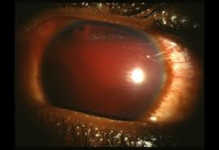

Slide 8
Investigation
Ultrasonography : high vitreous ecchos mostly vitreous hemorrhage
Complete blood picture : normal
Prothrombin time and concentration : normal

Slide 9
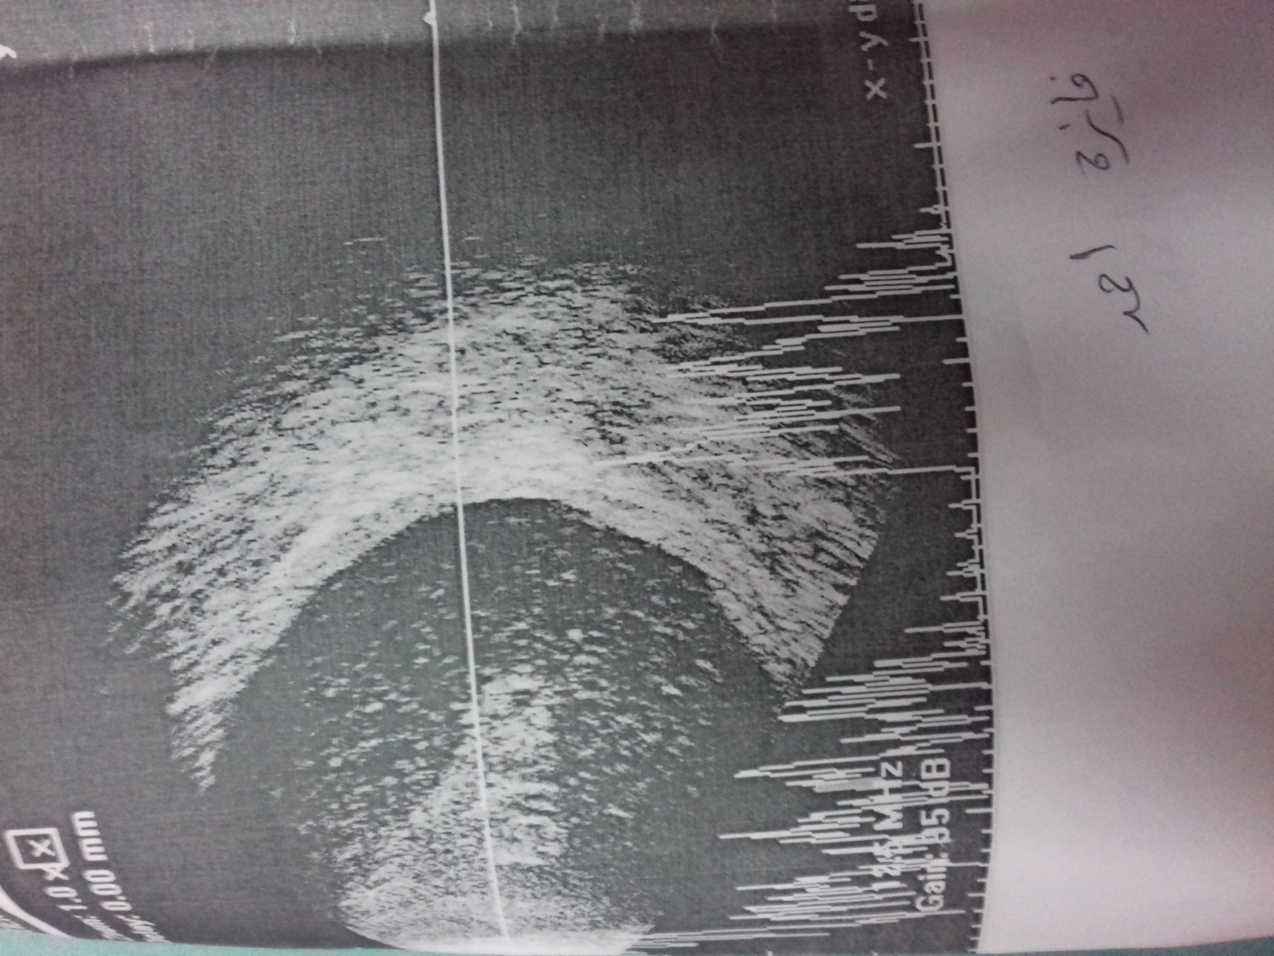

Slide 10
Diagnosis :
Acase of hyphema and vitreous haemorrhage with secondary increase of IOP

Slide 11
Management
Aim at prevention of secondary hemorrhage
and Control the elevated IOP to prevent corneal staining and optic neuropathy .

Slide 12
Lines of treatment:
1- topical antibiotic
2-topical steroid
3-topical anti-glaucoma
4-systemic carbonic anhydrase inhibitor (cidamex)
5-cycloplegico
6-haemostatic drugs (dicynone and kapron )

Slide 13


